Slide 1
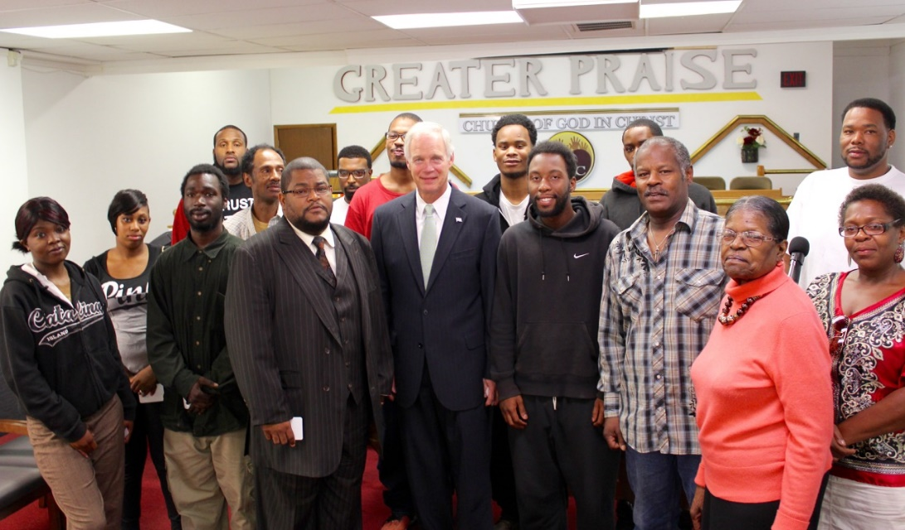
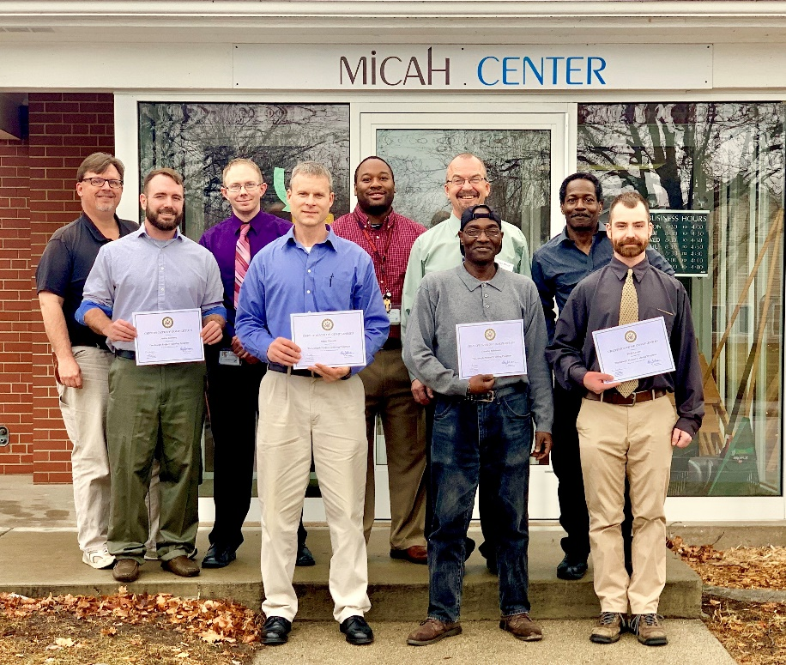
Changing Lives One Person at a Time

Slide 2
Value Proposition
In six years of traveling around Wisconsin, I have yet to visit a manufacturing company that can find enough people to meet their hiring needs, but you look at neighborhoods in Milwaukee and still see high rates of unemployment. That’s why we started The Joseph Project. We saw a need for making the connection between people who are genuinely seeking opportunity and the opportunities that exist around the state.
Senator Ron Johnson

Slide 3
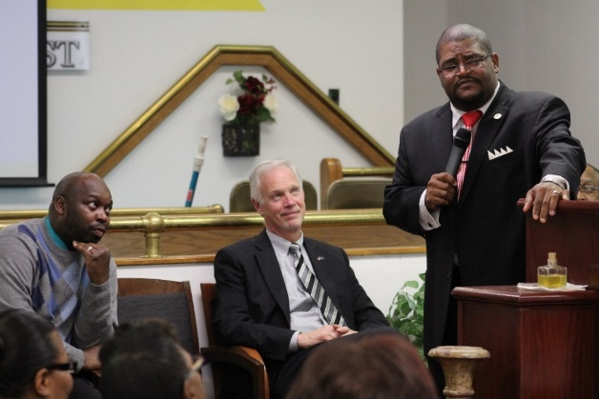
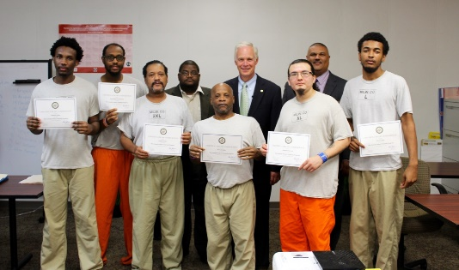
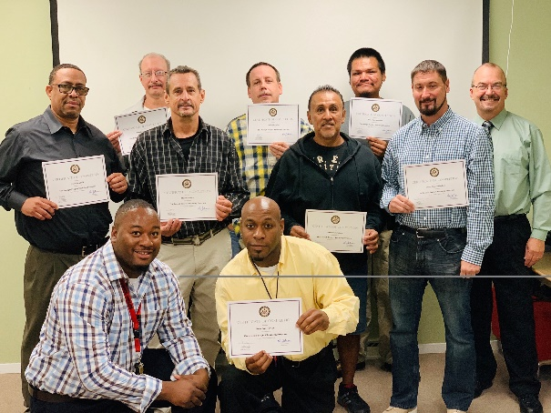
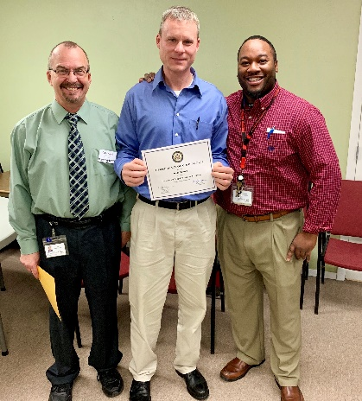
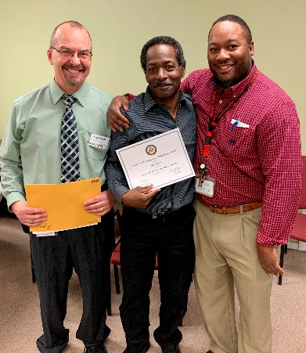
The Joseph Project Mission Statement
Connect those genuinely seeking opportunity with opportunities that already exist.
Notes:
We are aware of the opportunities. We need to determine your commitment, and then connect you with a new opportunity.

Slide 4
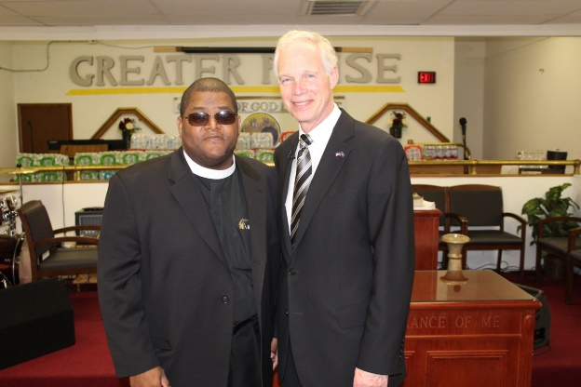
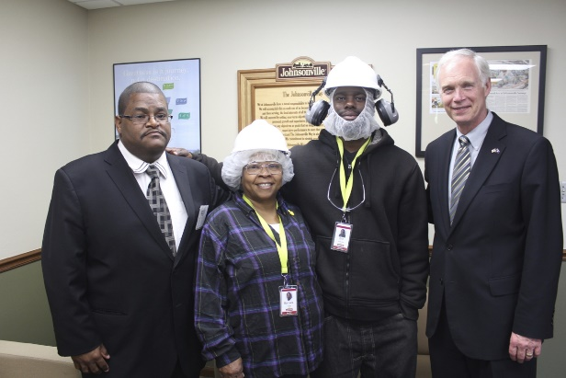
Who we are
A partnership between the faith and business communities
We remove the obstacles to good paying jobs
Volunteers
We accept no federal or state tax dollars

Slide 5
The Joseph Project
Self contained, comprehensive path to employment
Completed end to end in one week
Standardized process for employers and candidates
Market tested critical path that works
Over five years experience in training essential employability skills
Scalable model which has been employed across the state
Notes:
Key differentiators…not a training program, but a finishing school – a networking ministry.

Slide 6
The Joseph Project
With nearly 100 workshops, the Joseph Project has provided essential skills training for over 750 people in Wisconsin.
The cost of the essential skills workshop is less than $225 per person. [No taxpayer $$$]
To date the Joseph Project has provided over $47 million dollars of positive economic impact.
Every person off the poverty rolls saves taxpayers $50,000 per year.
The average starting wage for our graduates is $15 per hour.
Notes:
Efficacy!!
Job Corps spent $1.7 billion and cost approximately $33,990 per student for the full year 2017.
In March 2018, the DOL IG found that, “Job Corps could not demonstrate the extent to which its training programs helped participants enter meaningful jobs appropriate to their training. “

Slide 7
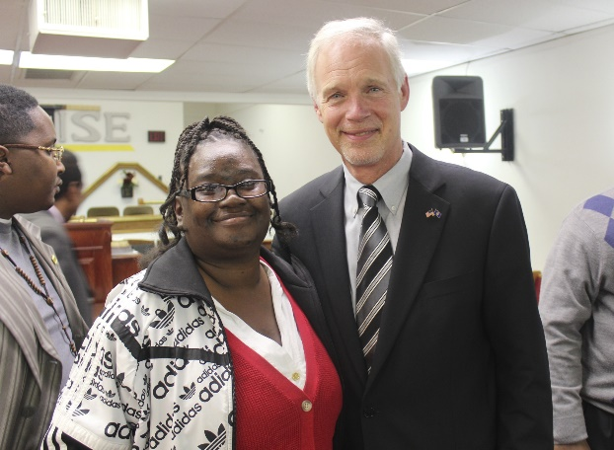
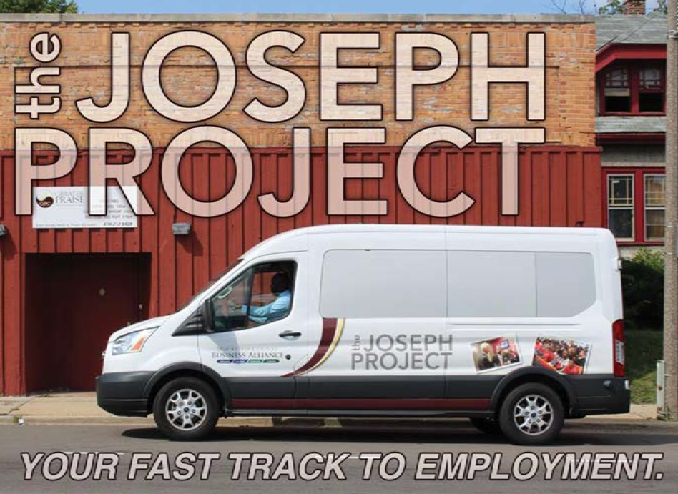
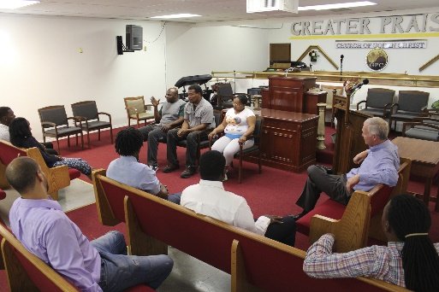
What we do
Find and vet potential
applicants
Essential skills workshop
Interviews
Transportation
Mentorship
Advocacy

Slide 8
How We Do It
Create sufficient key touches to influence candidates
Intake
Orientation
Essential Skills Workshop focused on three areas:
Interview performance
Dealing with change/success
Joining a team
Mock interviews
Employer interviews
After care

Slide 9
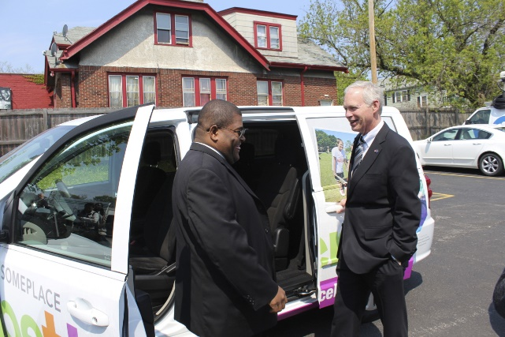
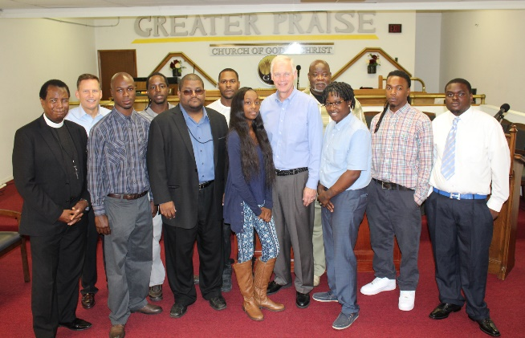
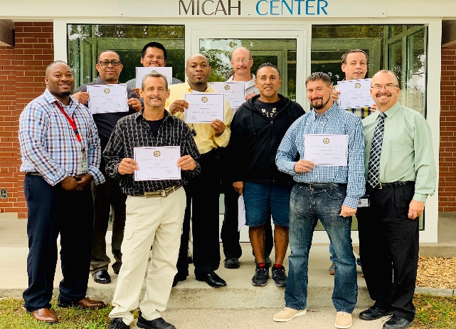
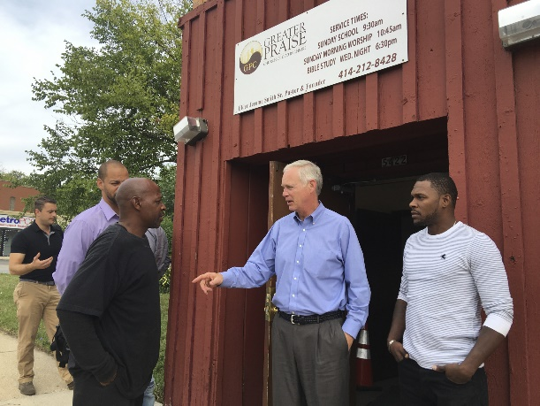
We Build Communities more than a partnership, it’s a cooperative
Candidates
Business Partners
Volunteers
Staff
Community
Faith Community
Notes:
The backbone, cornerstone, foundation is Pastor Jerome Smith. Community efforts outperform government programs.

Slide 10
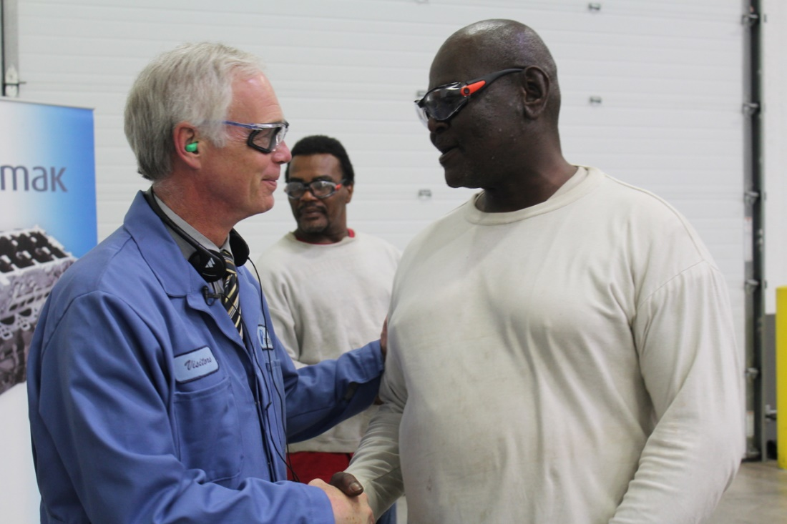
Ripple Effects
Making restitution
Escaping dependency
Combatting recidivism
Paying it forward
People are paying bills, buying things
Celebrating the dignity of work and living a purposeful life
Men and women setting positive examples for young people
Notes:
Re positive examples - George Will article…”Perhaps the decisive factors in combating poverty and enabling upward mobility were not economic but cultural — the habits, mores and dispositions that equip individuals to take advantage of opportunities.”

