Slide 1

Transitioning back to the workplace

Slide 2
Thoughtful Transition
Three phases, guided by state transition through Badger Bounce Back Plan
Intention: To provide a thought-out transition back to the traditional work schedule and environment while simultaneously empowering employees to adjust, both physically and emotionally, to changes in routine.
Not all will have the same comfort level and/or ability to return. Please talk to your department head.
Our only objective is a safe return to a healthy workplace.

Slide 3
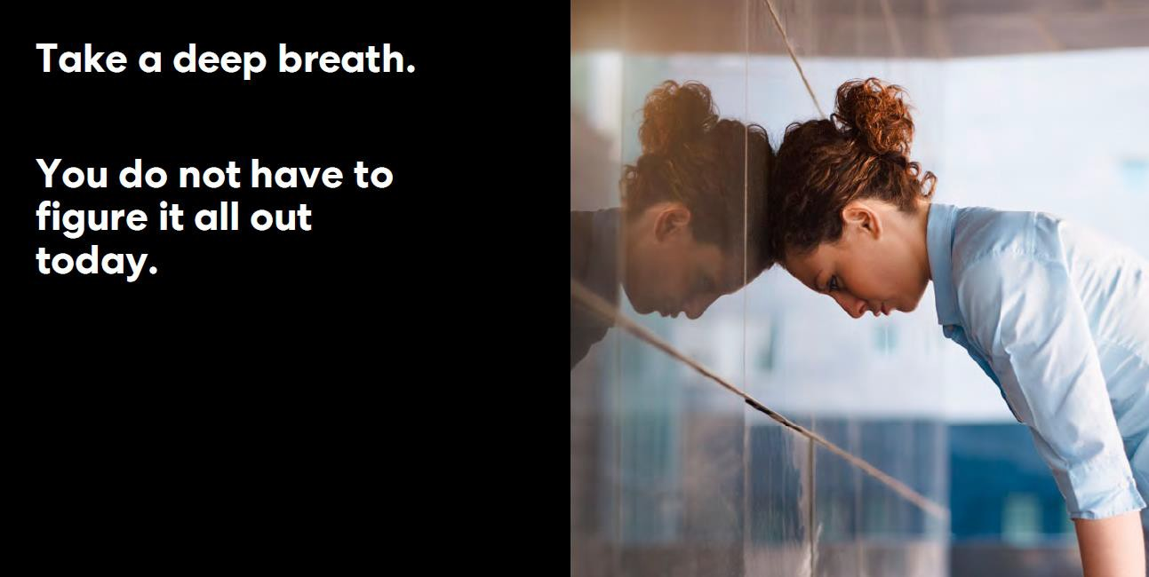

Slide 4
Thoughtful Transition*
Phase 2: TBD
Up to 75% of team members on site, or 15 individuals total, at any one time, as allowed by workstation social distancing measures:
Phase 3: TBD
Bring back 100% of team members under new BBBS work schedule, assuming social distancing measures can be relaxed.
Phase 1: Target 6/1
Up to 50% of team members, or 10 individuals total, on site at any one time:
Involves alternating team
members by week.
May require alterations to workstations
Requires 100% adherence to personal and office safety protocols as defined in following slides.
Involves rotating in team members to certain days onsite
May require alterations to workstations as necessary and/or temporary changes in workstation locations
Requires 100% adherence to personal and office safety protocols as defined in following slides.
Involves new guidelines for core office days/hours to optimize workplace and employee well-being
Increased capacity for remote work based on position and departmental guidelines.
Some precautions likely to continue; “new normal” standards put into place
*How long we remain in any phase is unknown.

Slide 5
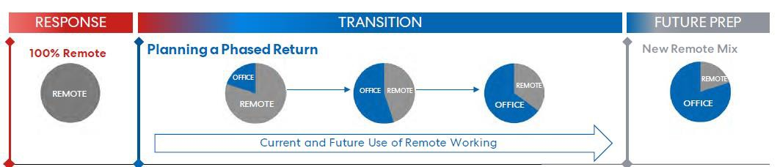
Current and Future Use of Remote Working
We are still determining what remote work will look like after we return to “normal”, we do know:
Increased capacity for remote work up to a maximum % of work hours
Specific capacity will be determined by position responsibilities and needs of business
Remote work guidelines will be developed and implemented if remote work is to be allowed.

Slide 6
Phase 1
Additional Components:
32-36 hours/week: Spread over 4 days
Community Engagement Team: Alyssa, Johnna, Amanda
Team 1: Site-based team, Pachee, Lisa Richardson (+Fridays)
Team 2: Community-based team
Alternating MTF or WThF: Jaime, Lindsay
37-40 hours/week: Spread over 5 days
No set “required” office hours or
arrival/departure schedule.
All borrowed office equipment must be returned on first day working back in office.
What equipment would you need at home?

Slide 7
 |  | Mon | Tues | Wed | Thurs | Fri
June | 1 | Team #1 Jaime CE | Team #2 Jaime | Team #1 Lindsay CE | Team #2 Lindsay | Lindsay Jaime Lisa R.
June | 8 | Team #2 Lindsay CE | Team #1 Lindsay | Team #2 Jaime CE | Team #1 Jaime | OPEN FOR 2
June15 |  | Team #1 Jaime CE | Team #2 Jaime | Team #1 Lindsay CE | Team #2 Lindsay | OPEN FOR 2
June | 22 | Team #2 Lindsay CE | Team #1 Lindsay | Team #2 Jaime CE | Team #1 Jaime | OPEN FOR 2

Slide 8
Increased Safety Precautions
PERSONAL HIGH TOUCH SURFACES
Phones and Headphones
Keyboards
Mice
Computer screens
Desktops
Window switch
Garbage
Increased sanitation throughout the building
  Sanitization stations at each “wing” entrance and in front lobby
  Individual offices have dedicated sanitizer stations
Increased Cleaning:
  Wed/Thurs: Individual high-touch surfaces cleaned and cleared
  Every Thursday: Deep-clean of non-porous, high-touch surfaces
  1st and 3rd Friday/Saturday: Linda cleans
FRIDAY: HIGH TOUCH SURFACES
Tabletops
Doorknobs
Light switches
Chairs
Bathroom/Kitchen handles and fixtures
Bathroom/Kitchen countertops
Toilet handles and lids
Increased air flow to buildings: open windows encouraged and air filters to be changed more frequently.
Masks required in hallways and group spaces. You can bring your own mask or use the one provided by BBBS.

Slide 9
Groups Precautions
Only 2 people in kitchen at a given time.
External gatherings: Must still uphold 6 ft social distancing requirement.
No public coffee or “group food”—Keurig will be moved to conference room with cleaning wipes for prior to
and after use
Conference room will have no more than 6 individuals at any given time
  Chairs will be removed for maximum benefit. Please do not add chairs
  Sanitation area will be provided with expectation to sanitize before and after each meeting
Team meetings will still have a Zoom link for those who prefer to call in and/or if there are more than 6 people involved in the meeting.

Slide 10
Health Screenings
Team members high encouraged to take temperature and do self-health check each morning
  Fever more than 100.4: stay home
Any team member feeling ill or displaying symptoms of illness (both COVID-19 and other
illness) are required to stay home
Until Phase 2, no professional travel and/or in-person meeting attendance allowed
Team members traveling commercially for personal reasons need to self-quarantine and either work remotely or use leave as appropriate for 14 days upon return.

Slide 11
Daily Practices In Office
Upon entering building, grab cleaning wipe to use to open door handles. Throw away
immediately. Grab a fresh cleaning wipe with every surface.
Generously use hand sanitizer/wash hands while in the building.
Do not share office spaces/equipment. Wipe down any open tables and chairs that you use.
Upon leaving for the day, wipe down office station and use cleaning wipe/towel/tissue to open doors.
Safer at 6: No matter where you are in the building, it is critical to practice proper social distancing by staying 6 feet from one another.

Slide 12
Personal Protective Equipment
Masks will be provided as you enter the building, in the kitchen, and in the conference room.
Team members are asked to wear a mask at all times except at your desk or in a conference
room where social distancing can be maintained.
You are allowed to bring and use your own mask if desired.

Slide 13
Personal Workspaces
Do not share workstations—use the space assigned to you.
Only 2 people allowed in any office at any given.
Remove candy dishes or anything that could be shared with others from your desk.
Use the sanitation stations to sanitize workstations.
If you plan to open your window, make sure to grab a window screen.

Slide 14
Visitors
Only essential visitors will be granted access to building.
Visitors will be required to complete a health questionnaire prior to entry
Visitors will be required to wear a mask and/or sit behind a plexi-glass partitian at all times.
Noncontact methods of greeting will continue (i.e. no handshaking)

Slide 15
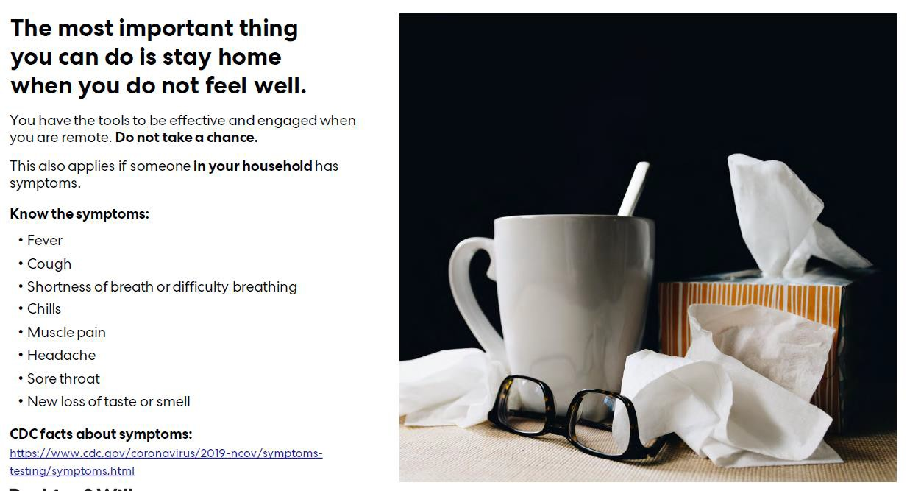

Slide 16
Remember….
Returning to the office during this transition phase is YOUR decision
It is ok if you do not feel comfortable. Talk with your department chair!
In your decision, take into consideration:
  Responsibilities to family and loved ones
  How you will travel to/from the office
  Your own level of comfort returning to the office
  Your level of risk

Slide 17
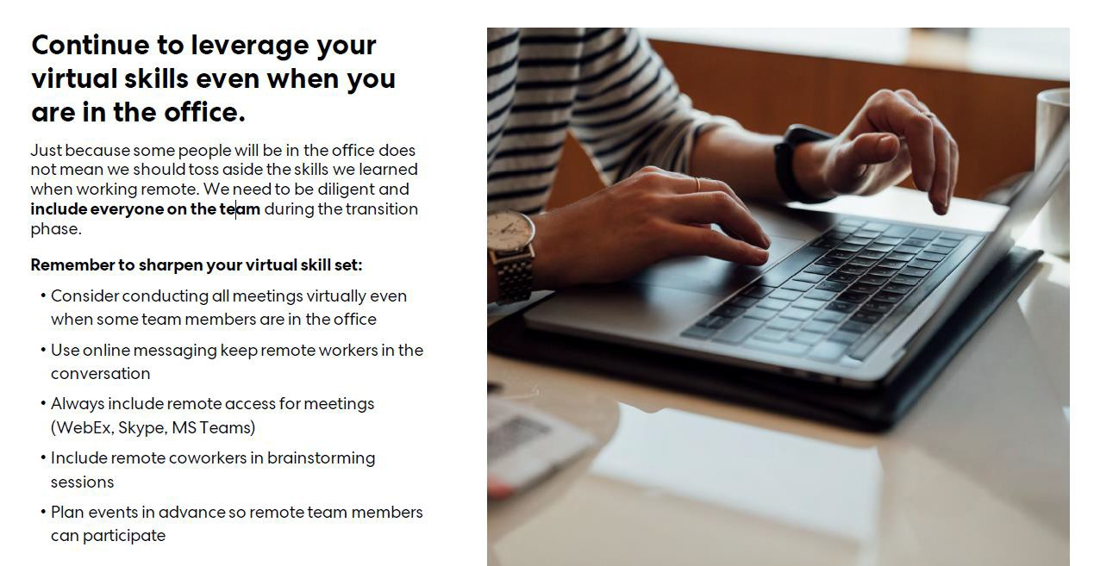

Slide 18
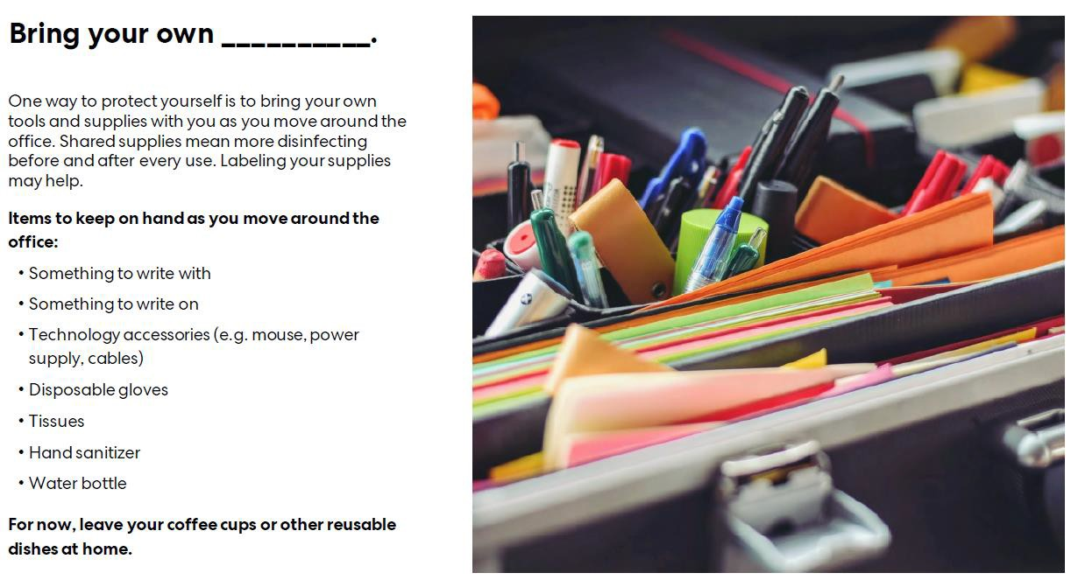

Slide 19
Questions
Pandemic Plan Administrator: Lindsay
  Additionally: FFCRA leave, and Technology
PPA Backup: Lisa Richardson
  All office equipment and cleaning supplies issues
Concerns/Challenges with returning to work: Department Chair

