Slide 1
Candid Conversation w/ Chad Pelishek, Director of Planning and Development

Slide 2
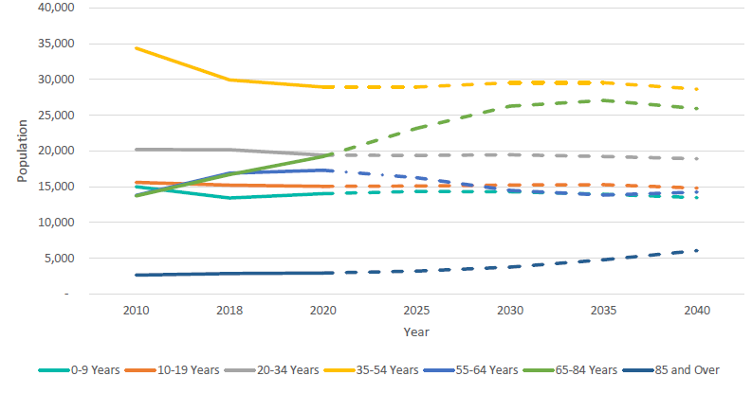
Recap of the Findings of the Recent Study
Age Cohort Projections-County

Slide 3
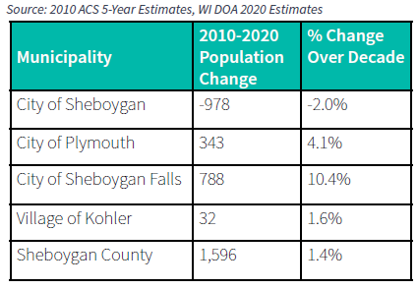
Population, Median & Per Capita Income

Slide 4
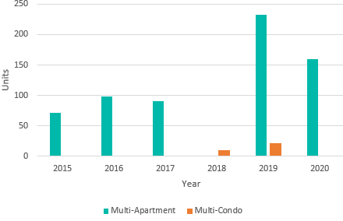
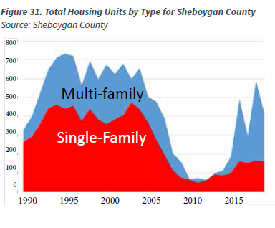
Building Permits 2015-2020

Slide 5
Rental Unit Vacancy Data as of 12/31/20
** A typical healthy vacancy rate is between 5% and 7%.
A vacancy rate around 5-7% provides an appropriate balance between supply and demand, with enough units to provide choices.

Slide 6
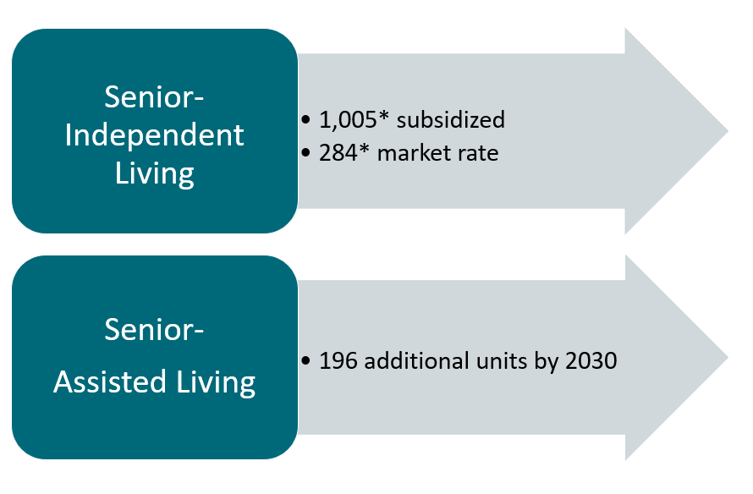
Demand Projections

Slide 7
Review of Current Residential Development

Slide 8
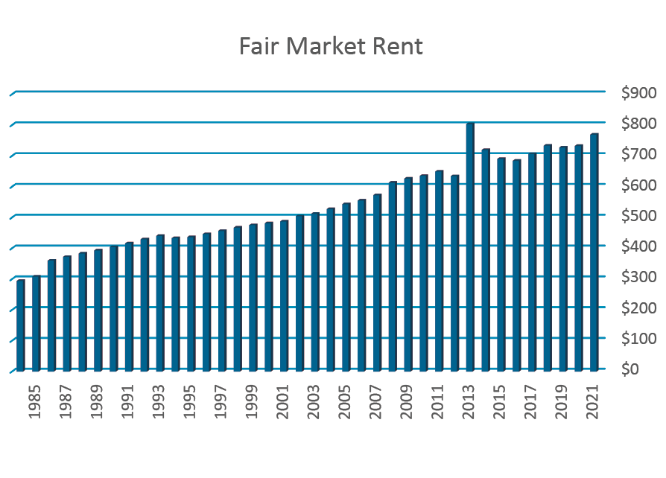
Fair Market Rent Rates for Sheboygan MSA
Fair Market Rent Rates: are used to determine payment standard amounts for Housing Choice Voucher Program and Section 8 Federally Funded housing programs. Based on 2 Bedroom unit.

Slide 9
Study Recommendations
https://www.sheboyganwi.gov/wp-content/uploads/2021/05/Affordable-Housing-Market-Study-2021.pdf

Slide 10
Funding Administered by City Development
CDBG Program- ~$920,000 per year.
Historic Preservation Grants, Public Service Grants
Revolving Loan Funds - ~$600,000 per year (Housing and Business related)
City funded Upper Floor and Façade Programs- $650,000
Other Grants
CDBG-CV2 funds from the State of Wisconsin- $242,000
US Fish and Wildlife funding for Evergreen and Kiwanis Park Projects- $196,000
AARP Community Challenge grants- $15,000
Bloomberg Asphalt Art Grant - $20,000
Coastal Management Grants- (ADA kayak launch at Kiwanis Park)
Sheboygan County Stewardship Grants (Kiwanis Park Trail)
State DNR and Federal HUD and EPA Grants- Various Projects (i.e. Beach restoration, streets, etc.)
Foundation Grants (Tony Hawk Foundation- Skate Park)

Slide 11
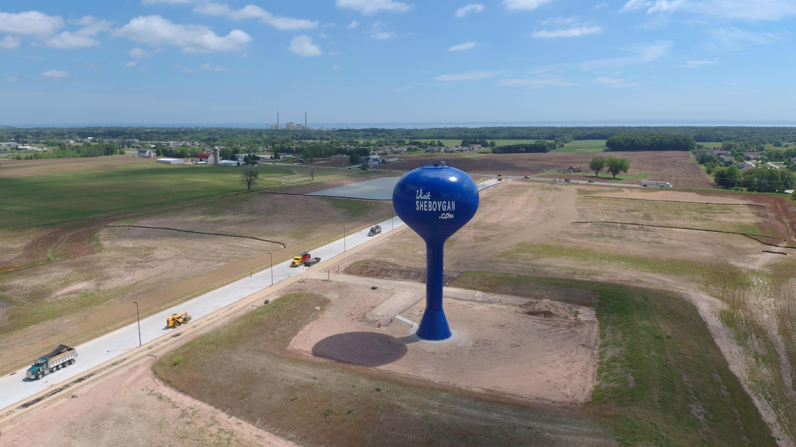
What keeps me up at night?
Development in the SouthPointe Enterprise Campus to be able to make the debt service payments of approximately $500,000 annually.
Payment would come from new development and taxes paid by the development

Slide 12
Outside City Structure
Planning and Development is made up of the four full-time staff members.
In order to accomplish economic and community development tasks we need outside partners.
Examples include:
Sheboygan County Economic Development Corporation
Sheboygan County Chamber of Commerce
Visit Sheboygan
Harbor Centre Business Improvement District
Neighborhood Associations (12 currently), Sheboygan Police Dept, Sheboygan Neighborhood Pride
Non-Profits working in the Community Development world…

Slide 13
Relationship with Non-Profits
Neighborhood Events- Rock the Block
City Green programming- JMKAC, Visit Sheboygan, Mead Public Library, Community Recreation Department.
Placemaking projects
Serving on community development city committees.
City of Sheboygan funds numerous non-profits to help meet the requirement of CDBG funding.
Yearly funds for mental health, domestic shelters, homeless shelters, budget counseling, childcare, transportation

Slide 14
What can Non-Profits do to help the City?
Share information and ideas
Even if the idea may not seem feasible, share information with Development staff who knows what will happen.
Partner on the projects- City has a diverse funding streams
Can administer programs that City staff does not have expertise in. (Lakeshore CAP administering a mortgage/utility assistance program with COVID funds)
Recommend policy changes that would help with a particular topic in the community.

Slide 15
What am I (team) most proud of?
Continuing to make Sheboygan a great place to live, work and play.
New development over the past 13 years.
New Multi-Family Housing- $162 million over six years
City Green Development
Revitalization of the Taylor Drive
Development of the SouthPointe Enterprise Campus
Continued revitalization and placemaking of the central business district.
Selling of the former Schuchadt property for the Art Preserve and Glacial Lakes Conservancy
Sheboygan River Clean-up project

Slide 16
What does inclusion look like in city development?
Housing for All- providing multiple types of the housing working towards livability (market rate, affordable, work-force, senior, low income, subsided)
Jobs/Economic Development- (providing job opportunities for the low to moderate income persons, middle class, and upper class). Administer Job creation for low-to-moderate income funding programs.
CDDG Requirements: Preference for Section 3- Women/Minority Owned business preferences
Implement programs like Pop-up Shops to allow entrepreneurs and people with a business idea an option to try a business.
Exploring community engagement techniques in a digital age. City is will be implementing a MyCIVIC which is an software solutions to connect communities and residents.
Senior Activity Center project funded with a 20 year note pledging future CDBG dollars.
City joining GARE: Government Alliance on Race and Equity

Slide 17
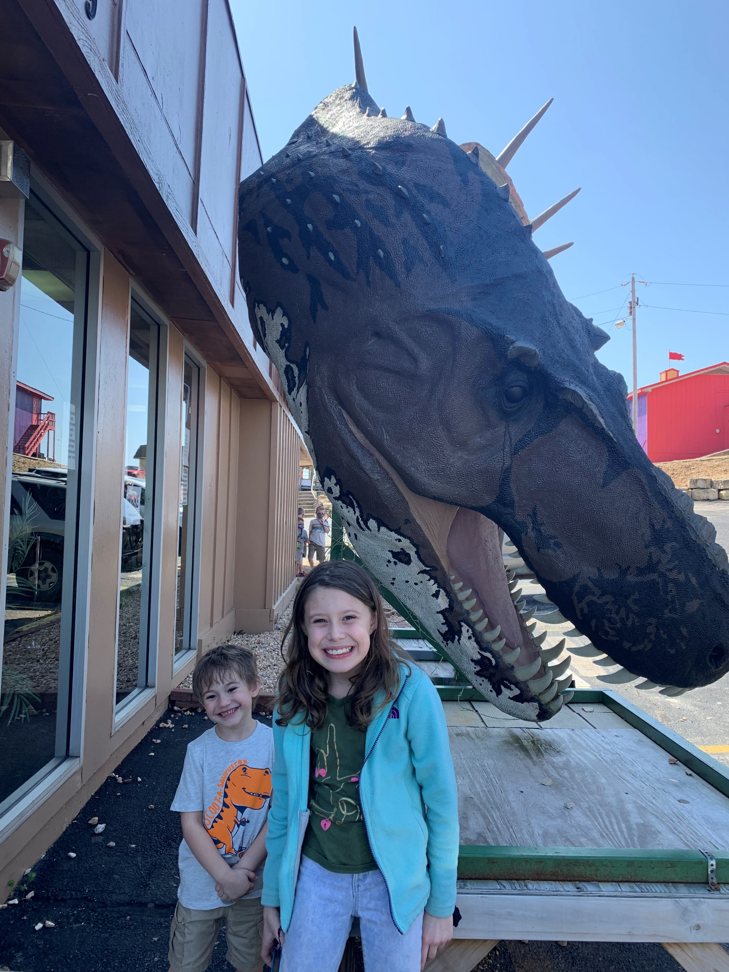
Why am I in Sheboygan?
Lake Michigan. I grew up in Kewaunee, moved to Green Bay and then moved Sheboygan. Always been attracted to what the Great Lakes have to offer.
Family. My wife is a certified hand therapist in Sheboygan. My two kids, Sofia- 9 and Caleb -4 attend Trinity Lutheran School downtown Sheboygan.
I love the small town atmosphere with big city amenities that Sheboygan has to offer.
I strongly believe that we need more young families living in central city neighborhoods, versus living in the suburbs, hence the reason on I own a single family home on N. 8th Street.

Slide 18
Questions?

