Slide 1


Slide 2
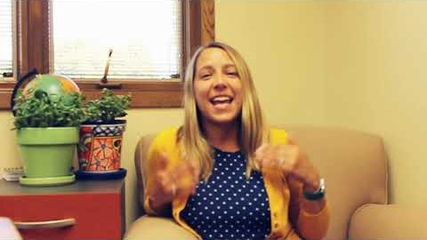

Thank you from all of us to you!
Notes:
Feel free to add any information from these materials to thank them for their donation last year:
Full Press Release
Thank You Video
Sheboygan County COVID-19 Relief Fund – if applicable

Slide 3

Last year because of your help…
EDUCATION
14,000 youth participated in programs to improve their future
589 parents received parenting education and support
1,000 welcome baby visits
FINANCIAL STABILITY
28,100 nights of shelter provided
5,300 people received budget counseling & financial education
779 families received housing assistance
HEALTH
455 students received weekly counseling services
76,000 meals delivered to the homebound
19,200 nutritious meals and snacks provided to students
Notes:
As a community, united we can accomplish so much more than we can alone. United Way of Sheboygan County strives to connect the social sector to resources, learn from one another, and collaborate to better serve our community. Investing in United Way allows your gift to go further as it will support 40 local programs, 2 community impact initiatives, the volunteer center and brings many together to convene large conversations and encourage collaboration.
This slide showcases a few of the outputs from last year’s investment.

Slide 4
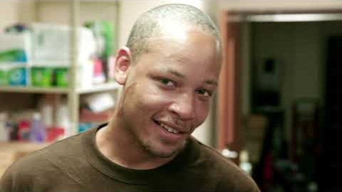
2020/2021 CAMPAIGN VIDEO
Notes:
About United Way – a reminder/refresher

Slide 5
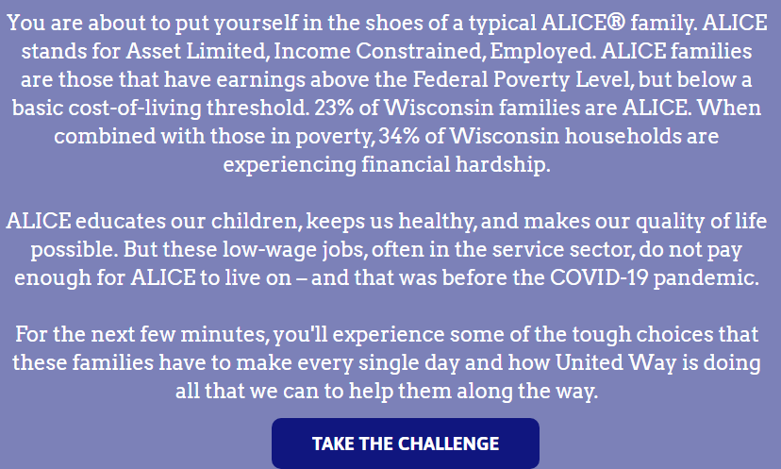
Making Tough Choices – Why We Give
What is ALICE?
ALICE Activity
Reflection
Notes:
ALICE stands for Asset Limited, Income Constrained, Employed.
Why give? We give for those that are in need of a helping hand. For those that have to ‘make tough choices’ every day.

Slide 6
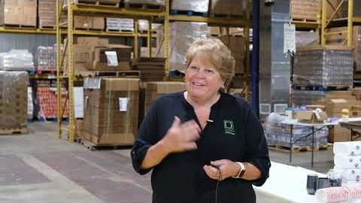
Partner Spotlight Video
One example of where your dollars are going in our community.
Notes:
Feature a partner spotlight video – find various video options on YouTube (https://www.youtube.com/channel/UCMSUzHJ5BWpyDyOsj4Z8uow?view_as=subscriber)

Slide 7
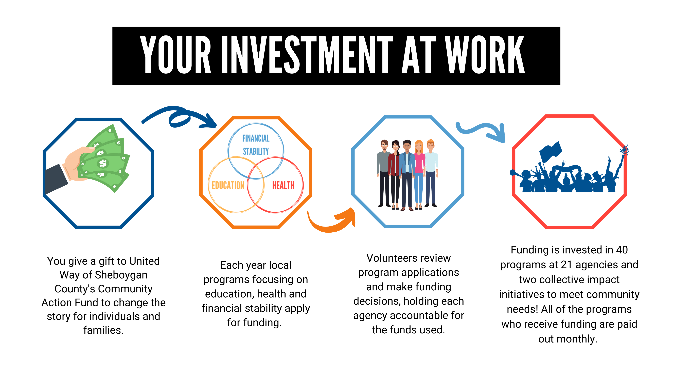
Where does my gift go?
Notes:
Explanation of what happens to your donation when you give to United Way

Slide 8
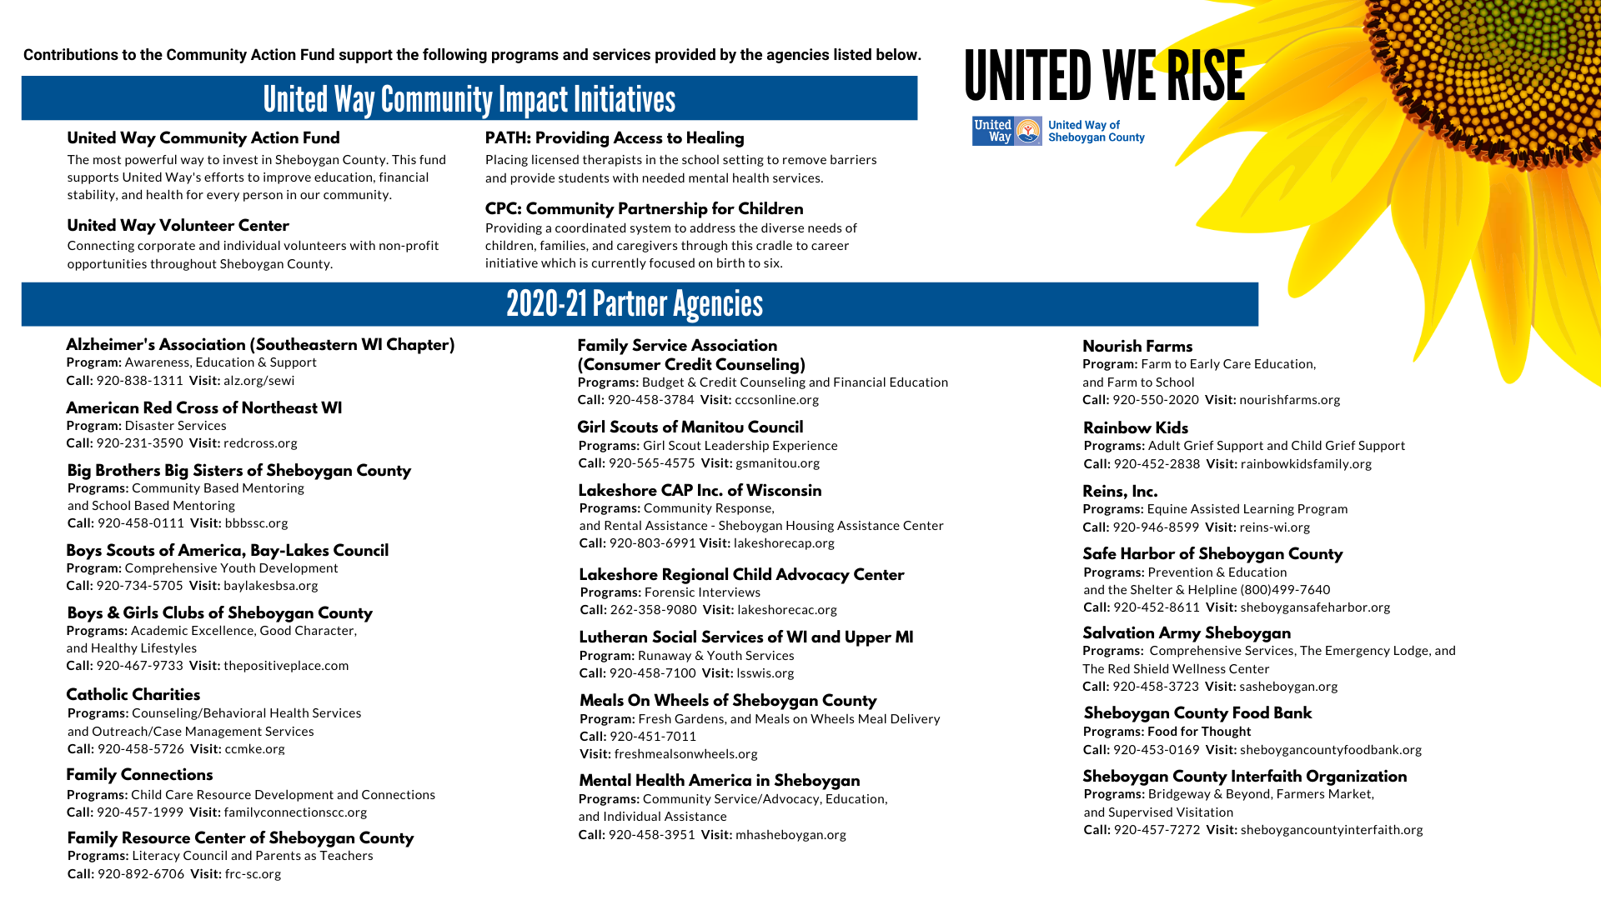

Slide 9


Slide 10
